Slide 1

Characterization presentation: Barcode reader
By: Omar Sharafy, Muhammad Biadsy
Instructor: Mony Orbach
Lab: HSDSL
Spring Semester 2024

Slide 2
Motivation
In Hospitals, samples are collected from patients.
each sample is labeled with barcode stickers, unique to each patient.
The samples are manually checked in the lab against patient details in the computer system.
the numerous number of samples received daily can lead to confusion and mix-ups between samples, potentially resulting in life-threatening medical errors.

Slide 3

Goals
Development of an easy to carry and simple tool that solves the problem of confusion in the hospital laboratory .
The tool should
Compare between barcodes and give us a clear result.
communicatee via Wi-Fi with a computer.
Save barcodes.
Mobile, compact and Re-chargeable.

Slide 4
Mod of work Diagram
Scan the “Golden barcode” & save it to the SD card
Scan a barcode we want to compare to the Golden
Get the result via sound + screen, and save the result
start
Scan the target barcode and save it to the SD Card

Slide 5
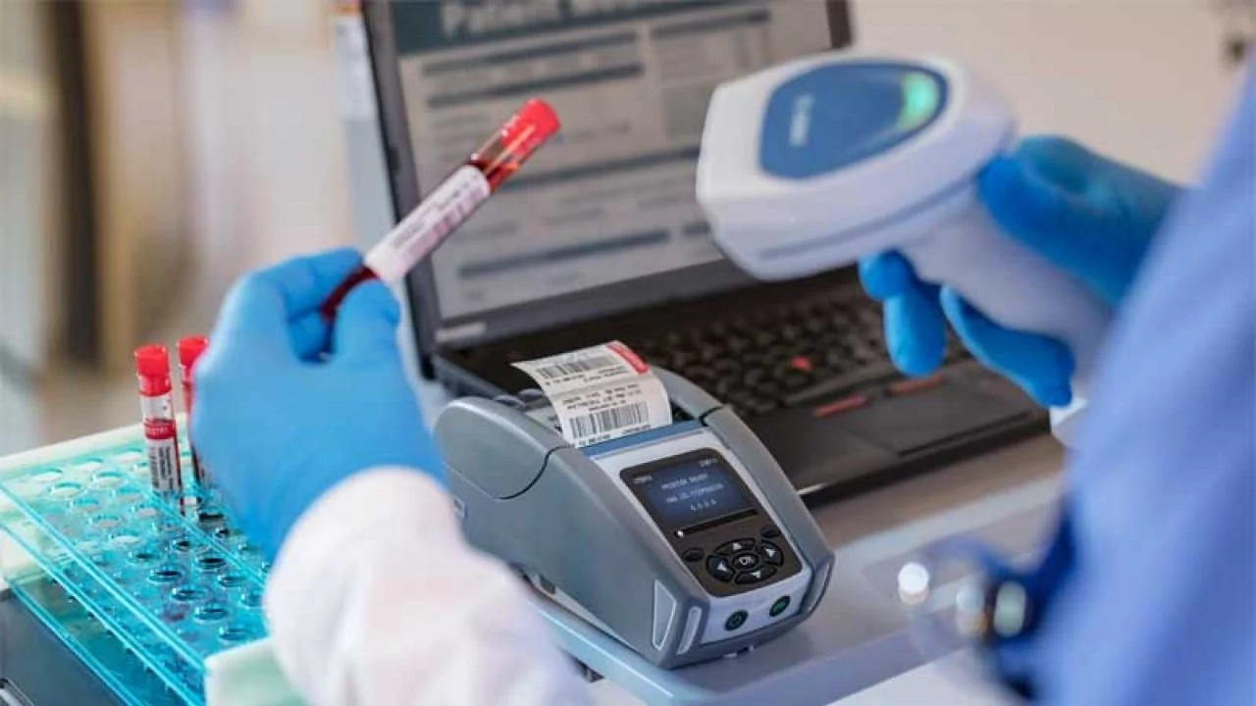
Mod of work
The device is designed to function in two distinct modes
Comparison Mode
The user scans a “golden barcode”.
The device compares another barcodes and provides feedback, indicating whether they match or not.
The " golden" barcode & the result are saved to an external SD card.

Slide 6
Mod of work
Saving Mode
The user scans a barcode.
The device saves the scanned barcode to the external SD card.

Slide 7
Block diagram
Power Supply Unit
RTC
Screen
ESP32
Barcode reader
LEDs
SD card

Slide 8
components
Barcode reader (Including built in buzzer).
Esp32.
Screen - SPI TFT LCD.
Realtime clk.
Charger – USB Type-C.
Sd card.
LEDs.
Notes:
Barcode Dimension 2.6*5.6*5.6cm
Screen 4.2 * 3.9 inches

Slide 9
Challenges
Finding a cheap and reliable 2D barcode reader.
Making sure our device is cheap and user friendly.
Concurrency between the components (esp32, real time clk, barcode reader…).
Combine tasks and timers.
Saving info into external SD card.

Slide 10
Tools and working environment chosen tools
Board : ESP32
Arduino developing environment

Slide 11
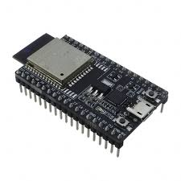
ESP32
Includes many drivers that make programming easier.
Advantages over Arduino nano: speed and memory
2 cores.
 | ESP32 | Arduino nano
Clock rate | 80 MHz | 16 MHz
Memory size | 520 KB SRAM 4 MB flash memory | 2 KB SRAM 32 KB flash

Slide 12
Barcode reader
2D Barcode scanner.
Built in buzzer that we can adapt it to our project.
Supports Arduino development Environment.
Notes:
125 mA = I
Built in buzzer
Built in led

Slide 13
Display
3.2 inch.
240X320 pixels.
Supports Arduino development Environment.
Can be powered with 3.3V.

Slide 14
Arduino developing environment
Supports the ESP32.
Rich collection of libraries for various sensors and communication protocols.
Easy to use and quickly start coding.
Supports wide range of applications.

Slide 15
Gant diagram
9June24 | 1July24 | 1august24 | 1sep24 | 15sep24
Middle presentation
Today
Choosing specific components
scheme
layout
Designing a case via 3D Printer
Code bring - up
Debug

Slide 16
Until Mid presentation
Advanced stage of layout.
Advanced stage of code.
Start designing the 3D case.

